Slide 1


Slide 2


TARGET
Money is the most envied, but the least enjoyed. Health is the most enjoyed, but the least envied.

Slide 3
Scope Document
Sr. No. | Particulars
1. | TEAM TARGET
2. | WHAT IS TARGET
3. | MARKETING AND PROMOTION SCHEME

Slide 4
Team target
Name of team :- Team Target
Members and Work Distribution :-
Suryaprakash Agarwal :- Made Screens
Abhishek Agrawal :- Made Video
Kartikay Bhalotia :- Presentation Part
Komal Mundhra :- Design of App
Radhika Rathi :- Made PowerPoint Presentation
Nimit Jain :- Marketing Scheme
Deadline :-
29th July, 2016

Slide 5
What is target ??
Win prizes for every time you walk, jog or bicycle.
Our app provide rewards for these activities you do on daily, weekly and annual basis.
It helps you to search and locate nearby training zones, gyms, etc.
Our team organizes different events, eco-friendly campaigns, etc.
Our app helps ‘busy’ people to make their schedule for Fitness.
Our app also tracks your position as well as your fitness target.
It also provide Professional Videos for learning basic exercises.

Slide 6
Marketing And Promotion
Scheme

Slide 7
Investment, promotion and Profit
Investment on :-
(i) Events
(ii) Ads on:-
Social Networking Sites
Newspaper
TV
Radio.
(iii) Rewards
2. Promotion :-
(i) Refer and Earn
(ii) Advertisement
3. Profit :-
(i) Scope of advertisement
(ii) Collaborations with GYMs, Doctors, etc.

Slide 8
Preview -
Target

Slide 9
Demonstration
Of
TARGET

Slide 10
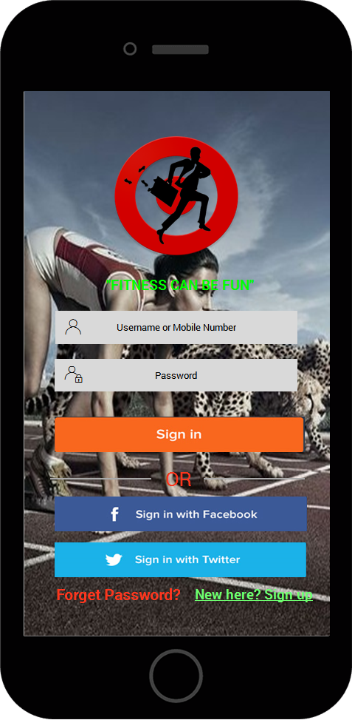
This is
our
‘Welcome Screen’

Slide 11
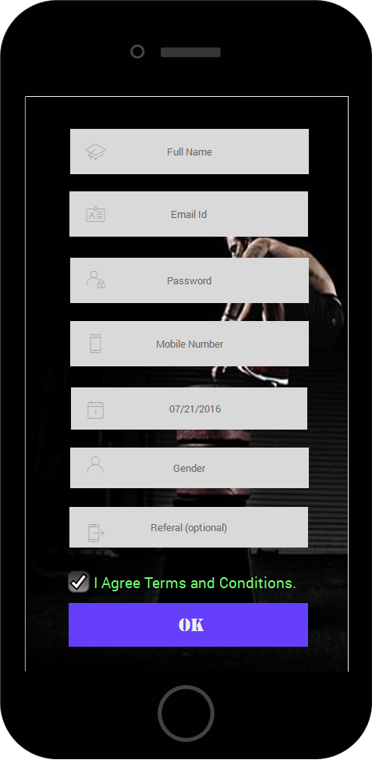
Your Profile Can be Edited Later On

Slide 12
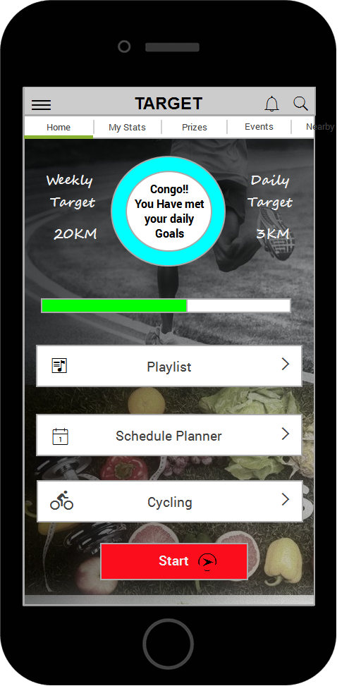
This is
Your
‘Dashboard’

Slide 13
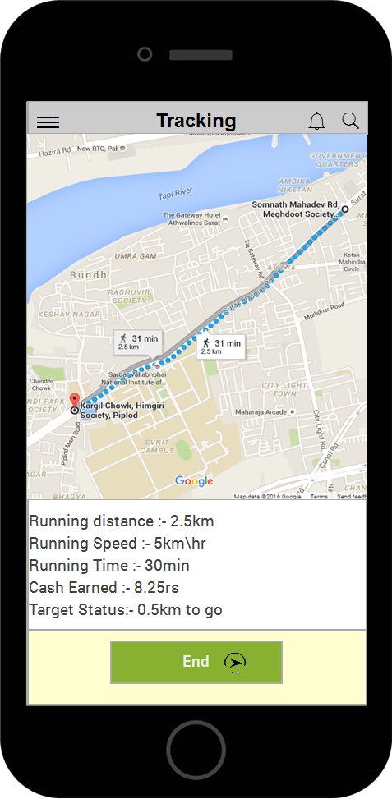
This app can
also Track
your
Daily Activities

Slide 14
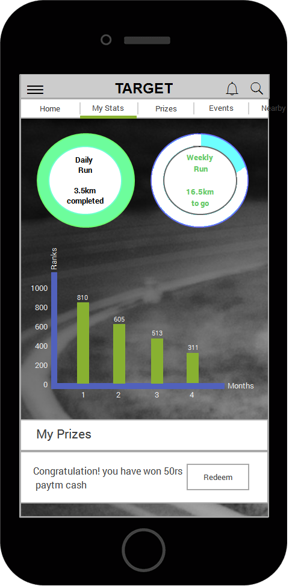
Here You Can
See What
You Have
Achieved

Slide 15
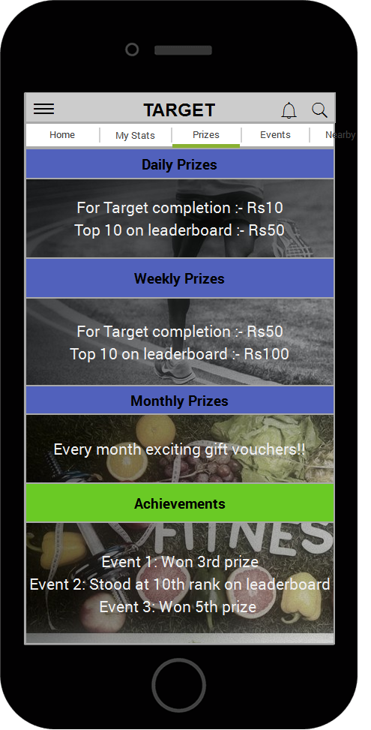
Here You Can
See The Prizes
You Can
Win

Slide 16
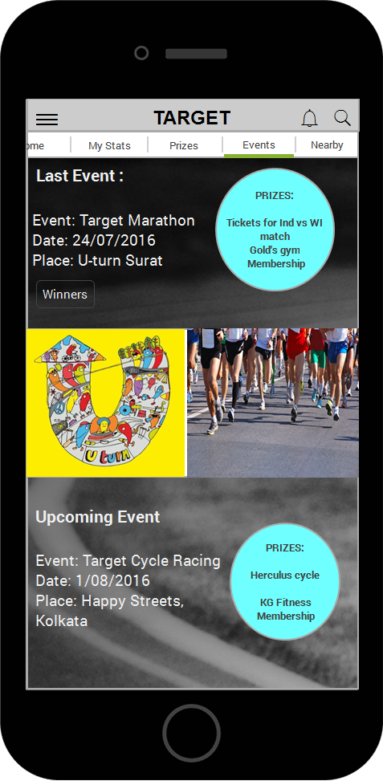
Here You can
See Upcoming
Events
and
Winners

Slide 17
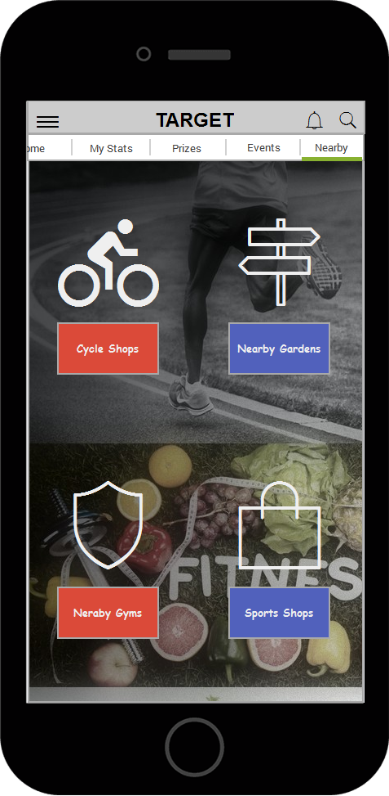
Can also
‘Search Nearby’
GYMS…..

Slide 18
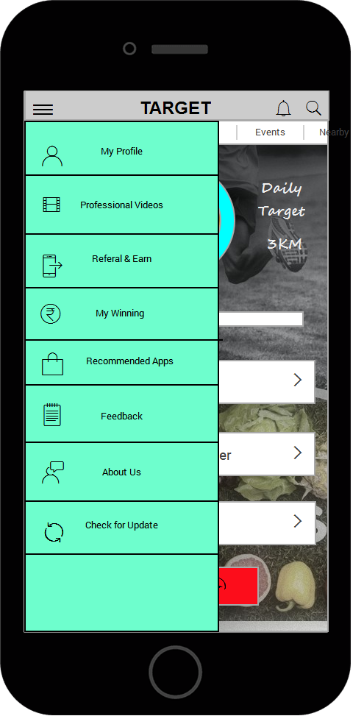
This is the
‘Sidebar’
For more
Options.

Slide 19
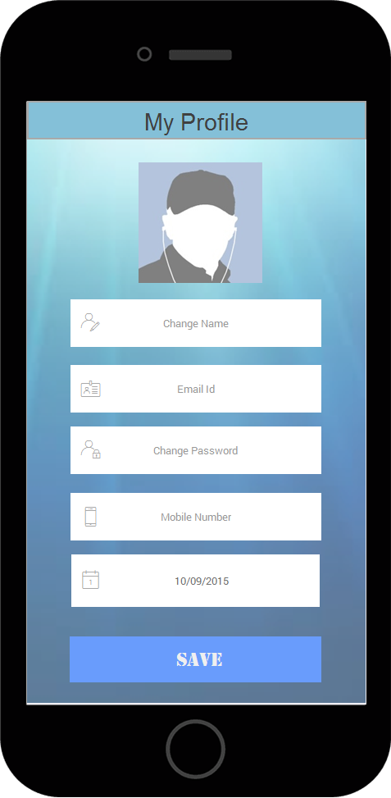
You can Edit
‘Your Profile’
Here

Slide 20
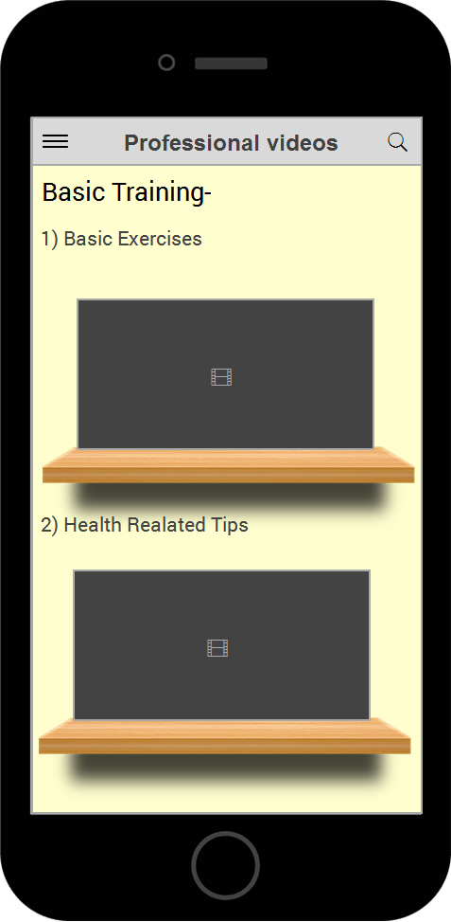
Can See
‘Training Videos’

Slide 21
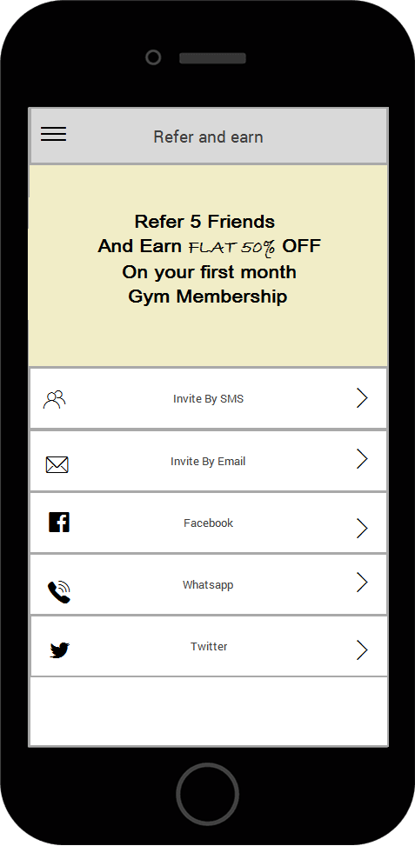
Refer Your
Friend
And Earn
Free
Membership

Slide 22
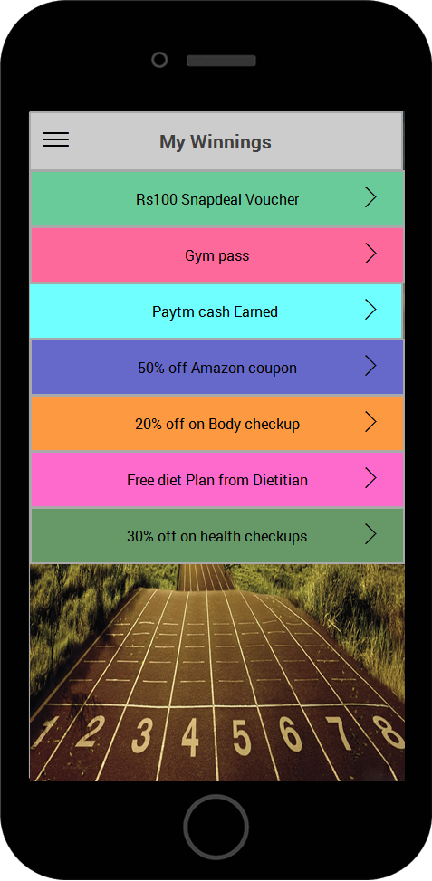
In this Section
You can see
Your
‘Winnings’

Slide 23
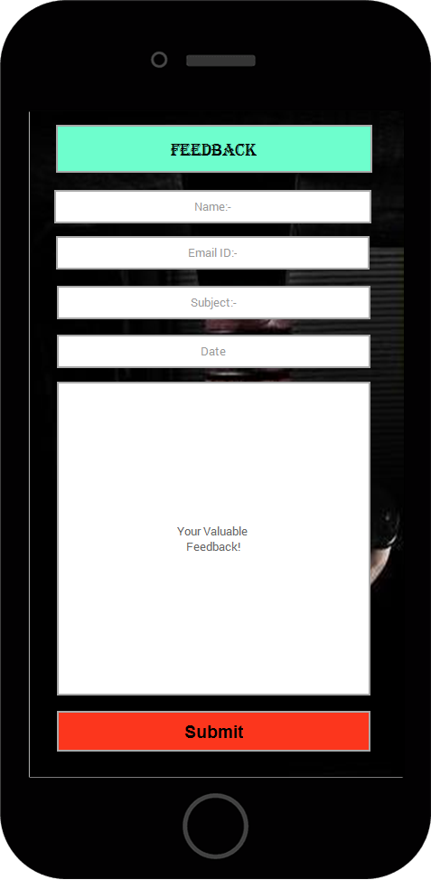
Your
Valuable
Feedback

Slide 24

Contributors

Slide 25
Swot analysis
Strength :-
Makes fitness Fun
Competitive Skills
Events
Weakness :-
Multiple Logins
Exercise Bikes
Opportunities :-
Need of Social Skills
Development of Tech.
Threats :-
Sustainability
Use of Automobiles

Slide 26
Any Questions ???

Slide 27
Thank You..!

